Slide 1

Khóa Thiết kế số 8/2025
Thực hiện:
GVHD: PGS. TS Nguyễn Đức Minh
Nguyễn Đình Anh 20233252
Notes:
(Object Detection, YOLO-Tinyv3/4)

Slide 2
Content
Introduction
Specifications
Synthesis result

Slide 3
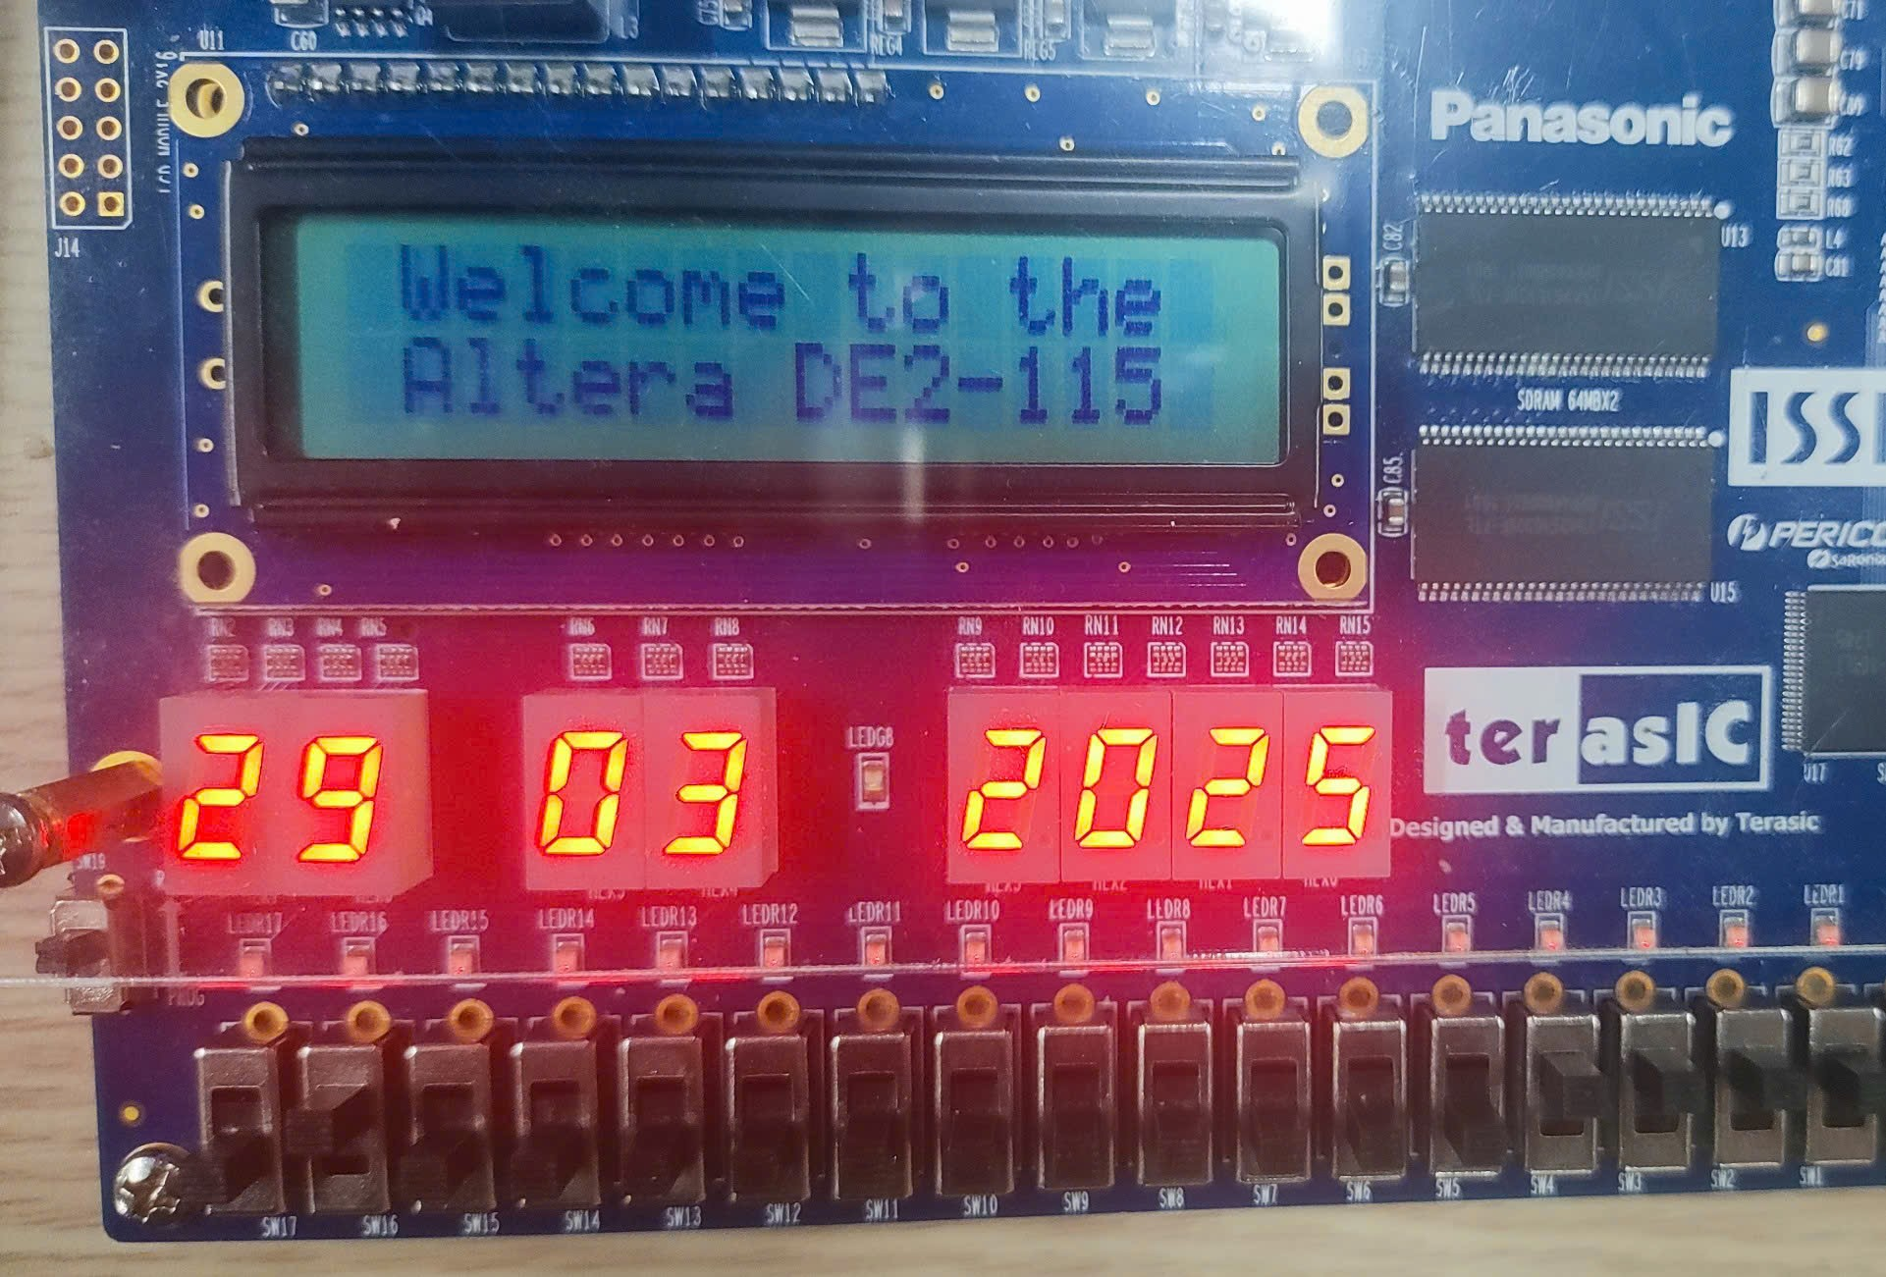
INTRODUCE
Millennium clock:
Able to display hours, minutes, seconds, and date (day, month, year)
Able to adjust/set the time and date
Buttons/switches perform functions according to the design
Implemented on the DE2-115 FPGA development board
Design language: Verilog

Slide 4
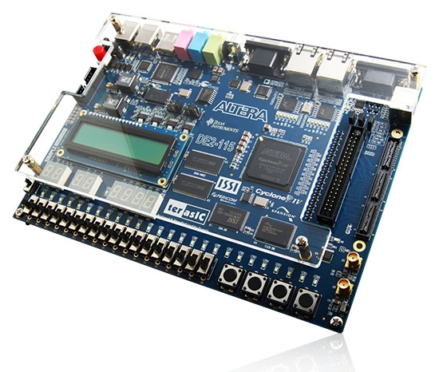
INTRODUCE
KIT FPGA DE2-115
Uses Altera Cyclone® IV FPGA chip (4CE115)
All peripheral connections are controlled via the FPGA
Built-in USB Blaster supports both JTAG and AS modes, configuration is stored in EPCS64
Includes 2MB SRAM, two 64MB SDRAM chips (total of 128MB), and 8MB Flash memory
4 buttons, 18 switches, 18 red LEDs, 9 green LEDs, 8 seven-segment displays, and one 16x2 LCD screen

Slide 5
SPECIFICATIONS
Input:
clk : 50MHz
rst_n: SW[0]
adjust_target: SW[2:1]
adjust_en: SW[3]
mode: SW[4]
up/down : KEY0/KEY1
Output: 8 seven-segment

Slide 6
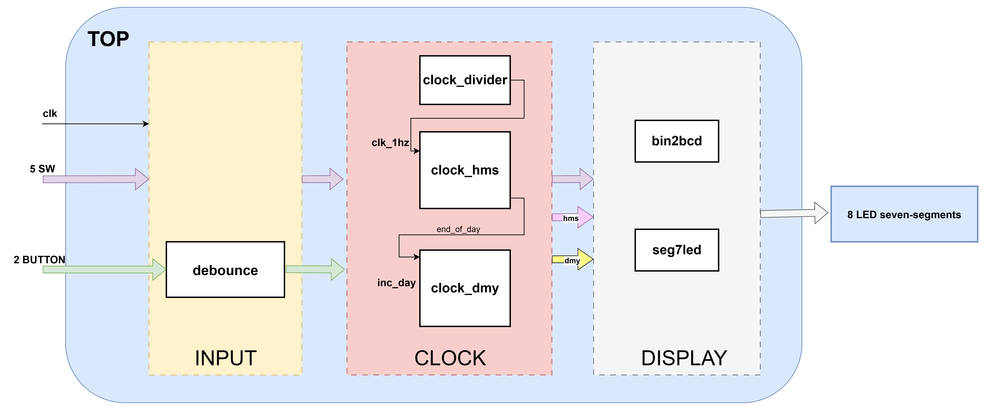
SPEC- OVERALL DESIGN

Slide 7
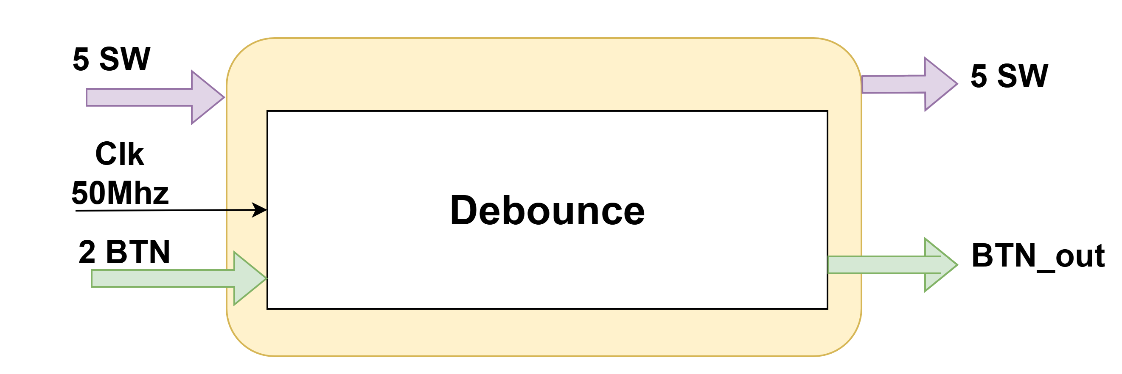
SPEC- INPUT BLOCK

Slide 8
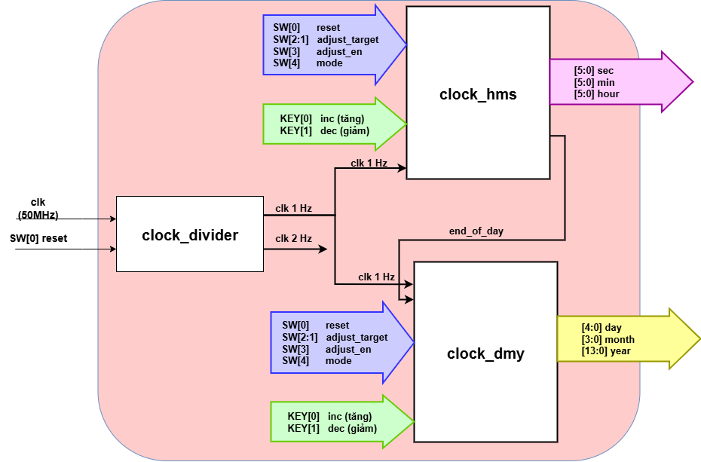
SPEC- CLOCK BLOCK

Slide 9
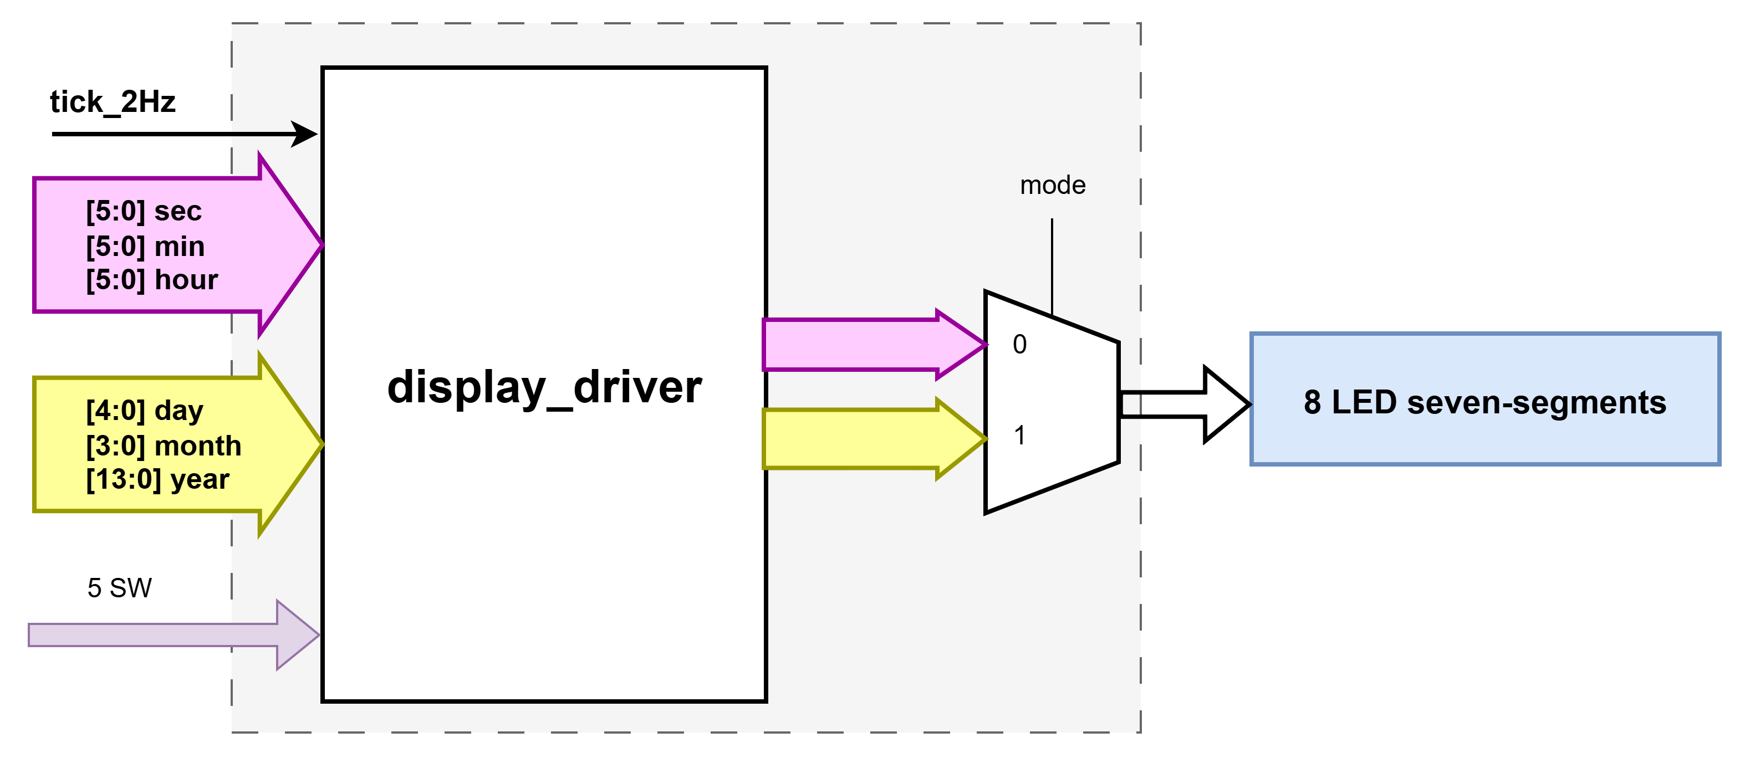
SPEC- DISPLAY BLOCK

Slide 10
RESULT
Synthesis result on Quartus:
Logic elements: 610
Registers: 139
Pins: 64
Synthesis resukt on ZCU:
LUT: 280
FF: 139

Slide 11

Testing video

Slide 12
Thank You !
www.themegallery.com

